Slide 1
Conventional Sorting Algorithms & Their Complexities
Course Code: CSC2211
Course Title: Algorithms
Dept. of Computer Science
Faculty of Science and Technology
Lecturer No: | 02.2 | Week No: | 02 | Semester: | Fall 20-21
Lecturer: | Mushfiqur Rahman; mushfiqur@aiub.edu

Slide 2
Lecture Outline
1. Sorting Algorithms
Insertion Sort
Selection Sort
Bubble Sort
Merge Sort
Quick Sort
Counting Sort

Slide 3
Quick Sort
Quick sort is based on the divide-and-conquer approach.
The idea is based on of choosing one element as a pivot element and partitioning the array around it such that:
Left side of pivot contains all the elements that are less than the pivot element.
Right side contains all elements greater than the pivot.
It reduces the space complexity and removes the use of the auxiliary array that is used in merge sort.
Selecting a random pivot in an array results in an improved time complexity in most of the cases.

Slide 4
Quick Sort Simulation [Ascending Order]:
0 | 1 | 2 | 3 | 4 | 5 | 6 | 7 | 8
List:
2 | 51 | 41 | 14 | 13 | 42 | 15 | 24 | 20
Let’s decide on the fact that we will always choose the last element of the list/ sub-list as the pivot element.
Then we are going put all the elements smaller than the pivot element on the left of it and all the elements greater than the pivot element on the right of it. This is called partitioning.

Slide 5
Quick Sort Simulation [Ascending Order]:
pivot
0 | 1 | 2 | 3 | 4 | 5 | 6 | 7 | 8
List:
2 | 51 | 41 | 14 | 13 | 42 | 15 | 24 | 20
So, 20 will be first pivot

Slide 6
Quick Sort Simulation [Ascending Order]:
p
i
pivot
0 | 1 | 2 | 3 | 4 | 5 | 6 | 7 | 8
List:
2 | 51 | 41 | 14 | 13 | 42 | 15 | 24 | 20
Now we start the process of partitioning.
We start with 0 index.
Here p and i both markers are used to keep similarity with the algorithm that is used later after this simulation so that you can make a connection and hopefully learn with ease.

Slide 7
Quick Sort Simulation [Ascending Order]:
p
i
pivot
0 | 1 | 2 | 3 | 4 | 5 | 6 | 7 | 8
List:
2 | 51 | 41 | 14 | 13 | 42 | 15 | 24 | 20

Slide 8
Quick Sort Simulation [Ascending Order]:
p
i
pivot
0 | 1 | 2 | 3 | 4 | 5 | 6 | 7 | 8
List:
2 | 51 | 41 | 14 | 13 | 42 | 15 | 24 | 20
List[i] <= List[pivot]
True
swap(List[i], List[p])
i++
p++

Slide 9
Quick Sort Simulation [Ascending Order]:
p
i
pivot
0 | 1 | 2 | 3 | 4 | 5 | 6 | 7 | 8
List:
2 | 51 | 41 | 14 | 13 | 42 | 15 | 24 | 20
List[i] <= List[pivot]
True
swap(List[i], List[p])
i++
p++

Slide 10
Quick Sort Simulation [Ascending Order]:
p
i
pivot
0 | 1 | 2 | 3 | 4 | 5 | 6 | 7 | 8
List:
2 | 51 | 41 | 14 | 13 | 42 | 15 | 24 | 20
List[i] <= List[pivot]
False
i++

Slide 11
Quick Sort Simulation [Ascending Order]:
p
i
pivot
0 | 1 | 2 | 3 | 4 | 5 | 6 | 7 | 8
List:
2 | 51 | 41 | 14 | 13 | 42 | 15 | 24 | 20
List[i] <= List[pivot]
False
i++

Slide 12
Quick Sort Simulation [Ascending Order]:
p
i
pivot
0 | 1 | 2 | 3 | 4 | 5 | 6 | 7 | 8
List:
2 | 51 | 41 | 14 | 13 | 42 | 15 | 24 | 20
List[i] <= List[pivot]
True
swap(List[i], List[p])
i++
p++

Slide 13
Quick Sort Simulation [Ascending Order]:
p
i
pivot
0 | 1 | 2 | 3 | 4 | 5 | 6 | 7 | 8
List:
2 | 51 | 41 | 14 | 13 | 42 | 15 | 24 | 20
List[i] <= List[pivot]
True
swap(List[i], List[p])
i++
p++

Slide 14
Quick Sort Simulation [Ascending Order]:
p
i
pivot
0 | 1 | 2 | 3 | 4 | 5 | 6 | 7 | 8
List:
2 | 14 | 41 | 51 | 13 | 42 | 15 | 24 | 20
List[i] <= List[pivot]
True
swap(List[i], List[p])
i++
p++

Slide 15
Quick Sort Simulation [Ascending Order]:
p
i
pivot
0 | 1 | 2 | 3 | 4 | 5 | 6 | 7 | 8
List:
2 | 14 | 41 | 51 | 13 | 42 | 15 | 24 | 20
List[i] <= List[pivot]
True
swap(List[i], List[p])
i++
p++

Slide 16
Quick Sort Simulation [Ascending Order]:
p
i
pivot
0 | 1 | 2 | 3 | 4 | 5 | 6 | 7 | 8
List:
2 | 14 | 41 | 51 | 13 | 42 | 15 | 24 | 20
List[i] <= List[pivot]
True
swap(List[i], List[p])
i++
p++

Slide 17
Quick Sort Simulation [Ascending Order]:
p
i
pivot
0 | 1 | 2 | 3 | 4 | 5 | 6 | 7 | 8
List:
2 | 14 | 13 | 51 | 41 | 42 | 15 | 24 | 20
List[i] <= List[pivot]
True
swap(List[i], List[p])
i++
p++

Slide 18
Quick Sort Simulation [Ascending Order]:
p
i
pivot
0 | 1 | 2 | 3 | 4 | 5 | 6 | 7 | 8
List:
2 | 14 | 13 | 51 | 41 | 42 | 15 | 24 | 20
List[i] <= List[pivot]
False
i++

Slide 19
Quick Sort Simulation [Ascending Order]:
p
i
pivot
0 | 1 | 2 | 3 | 4 | 5 | 6 | 7 | 8
List:
2 | 14 | 13 | 51 | 41 | 42 | 15 | 24 | 20
List[i] <= List[pivot]
True
swap(List[i], List[p])
i++
p++

Slide 20
Quick Sort Simulation [Ascending Order]:
p
i
pivot
0 | 1 | 2 | 3 | 4 | 5 | 6 | 7 | 8
List:
2 | 14 | 13 | 51 | 41 | 42 | 15 | 24 | 20
List[i] <= List[pivot]
True
swap(List[i], List[p])
i++
p++

Slide 21
Quick Sort Simulation [Ascending Order]:
p
i
pivot
0 | 1 | 2 | 3 | 4 | 5 | 6 | 7 | 8
List:
2 | 14 | 13 | 15 | 41 | 42 | 51 | 24 | 20
List[i] <= List[pivot]
True
swap(List[i], List[p])
i++
p++

Slide 22
Quick Sort Simulation [Ascending Order]:
p
i
pivot
0 | 1 | 2 | 3 | 4 | 5 | 6 | 7 | 8
List:
2 | 14 | 13 | 15 | 41 | 42 | 51 | 24 | 20
List[i] <= List[pivot]
False
i++

Slide 23
Quick Sort Simulation [Ascending Order]:
p
i
pivot
0 | 1 | 2 | 3 | 4 | 5 | 6 | 7 | 8
List:
2 | 14 | 13 | 15 | 41 | 42 | 51 | 24 | 20
swap(List[p], List[pivot])

Slide 24
Quick Sort Simulation [Ascending Order]:
p
i
pivot
0 | 1 | 2 | 3 | 4 | 5 | 6 | 7 | 8
List:
2 | 14 | 13 | 15 | 41 | 42 | 51 | 24 | 20
swap(List[p], List[pivot])

Slide 25
Quick Sort Simulation [Ascending Order]:
p
i
pivot
0 | 1 | 2 | 3 | 4 | 5 | 6 | 7 | 8
List:
2 | 14 | 13 | 15 | 20 | 42 | 51 | 24 | 41

Slide 26
Quick Sort Simulation [Ascending Order]:
0 | 1 | 2 | 3 | 4 | 5 | 6 | 7 | 8
2 | 14 | 13 | 15 | 20 | 42 | 51 | 24 | 41
0 | 1 | 2 | 3
2 | 14 | 13 | 15
Now, with the same partition logic as before, we are going to partition this sub-list.

Slide 27
Quick Sort Simulation [Ascending Order]:
0 | 1 | 2 | 3 | 4 | 5 | 6 | 7 | 8
2 | 14 | 13 | 15 | 20 | 42 | 51 | 24 | 41
0 | 1 | 2 | 3
2 | 14 | 13 | 15

Slide 28
Quick Sort Simulation [Ascending Order]:
0 | 1 | 2 | 3 | 4 | 5 | 6 | 7 | 8
2 | 14 | 13 | 15 | 20 | 42 | 51 | 24 | 41
0 | 1 | 2 | 3
2 | 14 | 13 | 15

Slide 29
Quick Sort Simulation [Ascending Order]:
0 | 1 | 2 | 3 | 4 | 5 | 6 | 7 | 8
2 | 14 | 13 | 15 | 20 | 42 | 51 | 24 | 41
0 | 1 | 2 | 3
2 | 14 | 13 | 15

Slide 30
Quick Sort Simulation [Ascending Order]:
0 | 1 | 2 | 3 | 4 | 5 | 6 | 7 | 8
2 | 14 | 13 | 15 | 20 | 42 | 51 | 24 | 41
0 | 1 | 2 | 3
2 | 14 | 13 | 15

Slide 31
Quick Sort Simulation [Ascending Order]:
0 | 1 | 2 | 3 | 4 | 5 | 6 | 7 | 8
2 | 14 | 13 | 15 | 20 | 42 | 51 | 24 | 41
0 | 1 | 2 | 3
2 | 14 | 13 | 15

Slide 32
Quick Sort Simulation [Ascending Order]:
0 | 1 | 2 | 3 | 4 | 5 | 6 | 7 | 8
2 | 14 | 13 | 15 | 20 | 42 | 51 | 24 | 41
0 | 1 | 2 | 3
2 | 14 | 13 | 15

Slide 33
Quick Sort Simulation [Ascending Order]:
0 | 1 | 2 | 3 | 4 | 5 | 6 | 7 | 8
2 | 14 | 13 | 15 | 20 | 42 | 51 | 24 | 41
0 | 1 | 2 | 3
2 | 14 | 13 | 15

Slide 34
Quick Sort Simulation [Ascending Order]:
0 | 1 | 2 | 3 | 4 | 5 | 6 | 7 | 8
2 | 14 | 13 | 15 | 20 | 42 | 51 | 24 | 41
0 | 1 | 2 | 3
2 | 14 | 13 | 15

Slide 35
Quick Sort Simulation [Ascending Order]:
0 | 1 | 2 | 3 | 4 | 5 | 6 | 7 | 8
2 | 14 | 13 | 15 | 20 | 42 | 51 | 24 | 41
0 | 1 | 2 | 3
2 | 14 | 13 | 15

Slide 36
Quick Sort Simulation [Ascending Order]:
0 | 1 | 2 | 3 | 4 | 5 | 6 | 7 | 8
2 | 14 | 13 | 15 | 20 | 42 | 51 | 24 | 41
0 | 1 | 2 | 3
2 | 14 | 13 | 15

Slide 37
Quick Sort Simulation [Ascending Order]:
0 | 1 | 2 | 3 | 4 | 5 | 6 | 7 | 8
2 | 14 | 13 | 15 | 20 | 42 | 51 | 24 | 41
0 | 1 | 2 | 3
2 | 14 | 13 | 15

Slide 38
Quick Sort Simulation [Ascending Order]:
0 | 1 | 2 | 3 | 4 | 5 | 6 | 7 | 8
2 | 14 | 13 | 15 | 20 | 42 | 51 | 24 | 41
0 | 1 | 2 | 3
2 | 14 | 13 | 15

Slide 39
Quick Sort Simulation [Ascending Order]:
0 | 1 | 2 | 3 | 4 | 5 | 6 | 7 | 8
2 | 14 | 13 | 15 | 20 | 42 | 51 | 24 | 41
0 | 1 | 2 | 3
2 | 14 | 13 | 15
0 | 1 | 2
2 | 14 | 13

Slide 40
Quick Sort Simulation [Ascending Order]:
0 | 1 | 2 | 3 | 4 | 5 | 6 | 7 | 8
2 | 14 | 13 | 15 | 20 | 42 | 51 | 24 | 41
0 | 1 | 2 | 3
2 | 14 | 13 | 15
0 | 1 | 2
2 | 14 | 13

Slide 41
Quick Sort Simulation [Ascending Order]:
0 | 1 | 2 | 3 | 4 | 5 | 6 | 7 | 8
2 | 14 | 13 | 15 | 20 | 42 | 51 | 24 | 41
0 | 1 | 2 | 3
2 | 14 | 13 | 15
0 | 1 | 2
2 | 14 | 13

Slide 42
Quick Sort Simulation [Ascending Order]:
0 | 1 | 2 | 3 | 4 | 5 | 6 | 7 | 8
2 | 14 | 13 | 15 | 20 | 42 | 51 | 24 | 41
0 | 1 | 2 | 3
2 | 14 | 13 | 15
0 | 1 | 2
2 | 14 | 13

Slide 43
Quick Sort Simulation [Ascending Order]:
0 | 1 | 2 | 3 | 4 | 5 | 6 | 7 | 8
2 | 14 | 13 | 15 | 20 | 42 | 51 | 24 | 41
0 | 1 | 2 | 3
2 | 14 | 13 | 15
0 | 1 | 2
2 | 14 | 13

Slide 44
Quick Sort Simulation [Ascending Order]:
0 | 1 | 2 | 3 | 4 | 5 | 6 | 7 | 8
2 | 14 | 13 | 15 | 20 | 42 | 51 | 24 | 41
0 | 1 | 2 | 3
2 | 14 | 13 | 15
0 | 1 | 2
2 | 14 | 13

Slide 45
Quick Sort Simulation [Ascending Order]:
0 | 1 | 2 | 3 | 4 | 5 | 6 | 7 | 8
2 | 14 | 13 | 15 | 20 | 42 | 51 | 24 | 41
0 | 1 | 2 | 3
2 | 14 | 13 | 15
0 | 1 | 2
2 | 14 | 13

Slide 46
Quick Sort Simulation [Ascending Order]:
0 | 1 | 2 | 3 | 4 | 5 | 6 | 7 | 8
2 | 13 | 14 | 15 | 20 | 42 | 51 | 24 | 41
0 | 1 | 2 | 3
2 | 14 | 13 | 15
0 | 1 | 2
2 | 13 | 14

Slide 47
Quick Sort Simulation [Ascending Order]:
0 | 1 | 2 | 3 | 4 | 5 | 6 | 7 | 8
2 | 13 | 14 | 15 | 20 | 42 | 51 | 24 | 41
0 | 1 | 2 | 3
2 | 14 | 13 | 15
0 | 1 | 2
2 | 13 | 14
0
2

Slide 48
Quick Sort Simulation [Ascending Order]:
0 | 1 | 2 | 3 | 4 | 5 | 6 | 7 | 8
2 | 13 | 14 | 15 | 20 | 42 | 51 | 24 | 41
0 | 1 | 2 | 3
2 | 14 | 13 | 15
0 | 1 | 2
2 | 13 | 14
0
2

Slide 49
Quick Sort Simulation [Ascending Order]:
0 | 1 | 2 | 3 | 4 | 5 | 6 | 7 | 8
2 | 13 | 14 | 15 | 20 | 42 | 51 | 24 | 41
0 | 1 | 2 | 3
2 | 14 | 13 | 15
0 | 1 | 2
2 | 13 | 14
0
2
2
14

Slide 50
Quick Sort Simulation [Ascending Order]:
0 | 1 | 2 | 3 | 4 | 5 | 6 | 7 | 8
2 | 13 | 14 | 15 | 20 | 42 | 51 | 24 | 41
0 | 1 | 2 | 3
2 | 14 | 13 | 15
0 | 1 | 2
2 | 13 | 14
0
2
2
14

Slide 51
Quick Sort Simulation [Ascending Order]:
0 | 1 | 2 | 3 | 4 | 5 | 6 | 7 | 8
2 | 13 | 14 | 15 | 20 | 42 | 51 | 24 | 41
0 | 1 | 2 | 3
5 | 6 | 7 | 8
2 | 14 | 13 | 15
42 | 51 | 24 | 41
0 | 1 | 2
2 | 13 | 14
0
2
2
14

Slide 52
Quick Sort Simulation [Ascending Order]:
0 | 1 | 2 | 3 | 4 | 5 | 6 | 7 | 8
2 | 13 | 14 | 15 | 20 | 42 | 51 | 24 | 41
0 | 1 | 2 | 3
5 | 6 | 7 | 8
2 | 14 | 13 | 15
42 | 51 | 24 | 41
0 | 1 | 2
2 | 13 | 14
0
2
2
14

Slide 53
Quick Sort Simulation [Ascending Order]:
0 | 1 | 2 | 3 | 4 | 5 | 6 | 7 | 8
2 | 13 | 14 | 15 | 20 | 42 | 51 | 24 | 41
0 | 1 | 2 | 3
5 | 6 | 7 | 8
2 | 14 | 13 | 15
42 | 51 | 24 | 41
0 | 1 | 2
2 | 13 | 14
0
2
2
14

Slide 54
Quick Sort Simulation [Ascending Order]:
0 | 1 | 2 | 3 | 4 | 5 | 6 | 7 | 8
2 | 13 | 14 | 15 | 20 | 42 | 51 | 24 | 41
0 | 1 | 2 | 3
5 | 6 | 7 | 8
2 | 14 | 13 | 15
42 | 51 | 24 | 41
0 | 1 | 2
2 | 13 | 14
0
2
2
14

Slide 55
Quick Sort Simulation [Ascending Order]:
0 | 1 | 2 | 3 | 4 | 5 | 6 | 7 | 8
2 | 13 | 14 | 15 | 20 | 42 | 51 | 24 | 41
0 | 1 | 2 | 3
5 | 6 | 7 | 8
2 | 14 | 13 | 15
42 | 51 | 24 | 41
0 | 1 | 2
2 | 13 | 14
0
2
2
14

Slide 56
Quick Sort Simulation [Ascending Order]:
0 | 1 | 2 | 3 | 4 | 5 | 6 | 7 | 8
2 | 13 | 14 | 15 | 20 | 24 | 51 | 42 | 41
0 | 1 | 2 | 3
5 | 6 | 7 | 8
2 | 14 | 13 | 15
24 | 51 | 42 | 41
0 | 1 | 2
2 | 13 | 14
0
2
2
14

Slide 57
Quick Sort Simulation [Ascending Order]:
0 | 1 | 2 | 3 | 4 | 5 | 6 | 7 | 8
2 | 13 | 14 | 15 | 20 | 24 | 51 | 42 | 41
0 | 1 | 2 | 3
5 | 6 | 7 | 8
2 | 14 | 13 | 15
24 | 51 | 42 | 41
0 | 1 | 2
2 | 13 | 14
0
2
2
14

Slide 58
Quick Sort Simulation [Ascending Order]:
0 | 1 | 2 | 3 | 4 | 5 | 6 | 7 | 8
2 | 13 | 14 | 15 | 20 | 24 | 51 | 42 | 41
0 | 1 | 2 | 3
5 | 6 | 7 | 8
2 | 14 | 13 | 15
24 | 51 | 42 | 41
0 | 1 | 2
2 | 13 | 14
0
2
2
14

Slide 59
Quick Sort Simulation [Ascending Order]:
0 | 1 | 2 | 3 | 4 | 5 | 6 | 7 | 8
2 | 13 | 14 | 15 | 20 | 24 | 41 | 42 | 51
0 | 1 | 2 | 3
5 | 6 | 7 | 8
2 | 14 | 13 | 15
24 | 41 | 42 | 51
0 | 1 | 2
2 | 13 | 14
0
2
2
14

Slide 60
Quick Sort Simulation [Ascending Order]:
0 | 1 | 2 | 3 | 4 | 5 | 6 | 7 | 8
2 | 13 | 14 | 15 | 20 | 24 | 41 | 42 | 51
0 | 1 | 2 | 3
5 | 6 | 7 | 8
2 | 14 | 13 | 15
24 | 41 | 42 | 51
0 | 1 | 2
5
2 | 13 | 14
24
0
2
2
14

Slide 61
Quick Sort Simulation [Ascending Order]:
0 | 1 | 2 | 3 | 4 | 5 | 6 | 7 | 8
2 | 13 | 14 | 15 | 20 | 24 | 41 | 42 | 51
0 | 1 | 2 | 3
5 | 6 | 7 | 8
2 | 14 | 13 | 15
24 | 41 | 42 | 51
0 | 1 | 2
5
7 | 8
2 | 13 | 14
24
42 | 51
0
2
2
14

Slide 62
Quick Sort Simulation [Ascending Order]:
0 | 1 | 2 | 3 | 4 | 5 | 6 | 7 | 8
2 | 13 | 14 | 15 | 20 | 24 | 41 | 42 | 51
0 | 1 | 2 | 3
5 | 6 | 7 | 8
2 | 14 | 13 | 15
24 | 41 | 42 | 51
0 | 1 | 2
5
7 | 8
2 | 13 | 14
24
42 | 51
0
2
2
14

Slide 63
Quick Sort Simulation [Ascending Order]:
0 | 1 | 2 | 3 | 4 | 5 | 6 | 7 | 8
2 | 13 | 14 | 15 | 20 | 24 | 41 | 42 | 51
0 | 1 | 2 | 3
5 | 6 | 7 | 8
2 | 14 | 13 | 15
24 | 41 | 42 | 51
0 | 1 | 2
5
7 | 8
2 | 13 | 14
24
42 | 51
0
2
2
14

Slide 64
Quick Sort Simulation [Ascending Order]:
0 | 1 | 2 | 3 | 4 | 5 | 6 | 7 | 8
2 | 13 | 14 | 15 | 20 | 24 | 41 | 42 | 51
0 | 1 | 2 | 3
5 | 6 | 7 | 8
2 | 14 | 13 | 15
24 | 41 | 42 | 51
0 | 1 | 2
5
7 | 8
2 | 13 | 14
24
42 | 51
0
2
2
14

Slide 65
Quick Sort Simulation [Ascending Order]:
0 | 1 | 2 | 3 | 4 | 5 | 6 | 7 | 8
2 | 13 | 14 | 15 | 20 | 24 | 41 | 42 | 51
0 | 1 | 2 | 3
5 | 6 | 7 | 8
2 | 14 | 13 | 15
24 | 41 | 42 | 51
0 | 1 | 2
5
7 | 8
2 | 13 | 14
24
42 | 51
0
2
2
14

Slide 66
Quick Sort Simulation [Ascending Order]:
0 | 1 | 2 | 3 | 4 | 5 | 6 | 7 | 8
2 | 13 | 14 | 15 | 20 | 24 | 41 | 42 | 51
0 | 1 | 2 | 3
5 | 6 | 7 | 8
2 | 14 | 13 | 15
24 | 41 | 42 | 51
0 | 1 | 2
5
7 | 8
2 | 13 | 14
24
42 | 51
0
2
2
14

Slide 67
Quick Sort Simulation [Ascending Order]:
0 | 1 | 2 | 3 | 4 | 5 | 6 | 7 | 8
2 | 13 | 14 | 15 | 20 | 24 | 41 | 42 | 51
0 | 1 | 2 | 3
5 | 6 | 7 | 8
2 | 14 | 13 | 15
24 | 41 | 42 | 51
0 | 1 | 2
5
7 | 8
2 | 13 | 14
24
42 | 51
0
2
7
2
14
42

Slide 68
Quick Sort Simulation [Ascending Order]:
SORTED
0 | 1 | 2 | 3 | 4 | 5 | 6 | 7 | 8
2 | 13 | 14 | 15 | 20 | 24 | 41 | 42 | 51
0 | 1 | 2 | 3
5 | 6 | 7 | 8
2 | 14 | 13 | 15
24 | 41 | 42 | 51
0 | 1 | 2
5
7 | 8
2 | 13 | 14
24
42 | 51
0
2
7
2
14
42

Slide 69
Quick Sort Simulation [Ascending Order]:
For pen-paper simulation, you need to only draw this final state of the simulation. However, to get to this state, you have to perform the simulation by rearranging and overwriting the different states of list and sub-lists from the start (in the same picture without drawing it each time).
0 | 1 | 2 | 3 | 4 | 5 | 6 | 7 | 8
2 | 13 | 14 | 15 | 20 | 24 | 41 | 42 | 51
0 | 1 | 2 | 3
5 | 6 | 7 | 8
2 | 14 | 13 | 15
24 | 41 | 42 | 51
0 | 1 | 2
5
7 | 8
2 | 13 | 14
24
42 | 51
0
2
7
2
14
42

Slide 70
Quick Sort [Algorithm]:
partition(mainArray, start, end){
pivot = mainArray[end]
p = start
for(i=start; i<end; i++){
if(mainArray[i] <= pivot){
swap(mainArray[i], mainArray[p])
p++
}
}
swap(mainArray[p], mainArray[end]) //swapping with pivot
return p;
}
quicksort(mainArray, start, end){
if(start < end){
p = partition(mainArray, start, end)
quicksort(mainArray, start, p-1)
quicksort(mainArray, p+1, end)
}
}

Slide 71
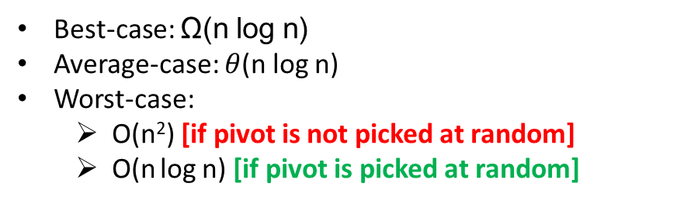
Quick Sort [Time Complexity]:
Best-case: Ω(n log n)
Average-case: $θ$(n log n)
Worst-case:
O(n²) [if pivot is not picked at random]
O(n log n) [if pivot is picked at random]
Quick Sort [Space Complexity]:
O(n) [if pivot is not picked at random]
O(n log n) [if pivot is picked at random]

Slide 72
Quick Sort [Algorithm][When pivot is picked randomly]:
partition(mainArray, start, end){
pivot = mainArray[end]
p = start
for(i=start; i<end; i++){
if(mainArray[i] <= pivot){
swap(mainArray[i], mainArray[p])
p++
}
}
swap(mainArray[p], mainArray[end]) //swapping with pivot
return p;
}
randPartition(mainArray, start, end){
randPivot = randomGenerator(start, end) //will pick a random number between start and end swap(mainArray[randPivot], mainArray[end])
partition(mainArray, start, end)
}
quicksort(mainArray, start, end){
if(start < end){
p = randPartition(mainArray, start, end)
quicksort(mainArray, start, p-1)
quicksort(mainArray, p+1, end)
}
}

Slide 73
Counting Sort
Counting sort: No comparisons between elements.
Input: A[1 . . n], where A[j] ∈ {1, 2, . . . , k}.
Output: B[1 . . n], sorted.
Auxiliary storage: C [1 . . k].
1 for i ← 1 to k
2
3 for j ← 1 to n
4
5 for i ← 2 to k
6
7 for j ← n downto 1 8
9
do C [i ] ← 0
do C [A[j]] ← C [A[j]] + 1
d C [i ] = |{key = i }|
d C [i ] = |{key ≤ i }|
do C [i ] ← C [i ] + C [i − 1]
do B[C [A[j]]] ← A[j]
C [A[j]] ← C [A[j]] − 1
12 / 26

Slide 74
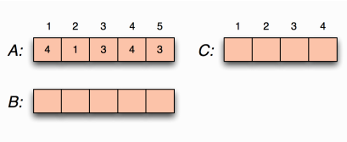
Counting sort example

Slide 75
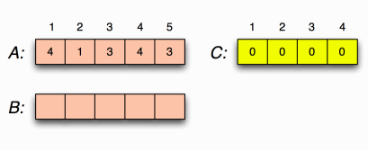
Counting sort example Loop 1
for i ←1 to k
do C [i ] ←0

Slide 76
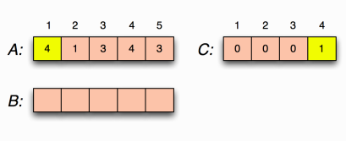
Counting sort example Loop 2
for j ←1 to n
do C [A[j ]] ←C [A[j ]] + 1
C [i ] = |{key = i}|

Slide 77
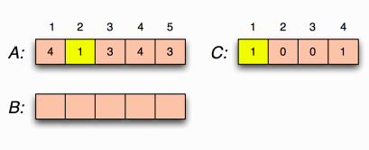
Counting sort example Loop 2
for j ←1 to n
do C [A[j ]] ←C [A[j ]] + 1
C [i ] = |{key = i}|

Slide 78
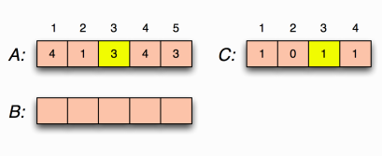
Counting sort example Loop 2
for j ←1 to n
do C [A[j ]] ←C [A[j ]] + 1
C [i ] = |{key = i}|

Slide 79
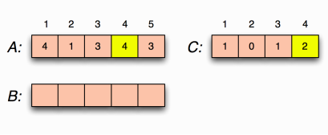
Counting sort example Loop 2
for j ←1 to n
do C [A[j ]] ←C [A[j ]] + 1
C [i ] = |{key = i}|

Slide 80
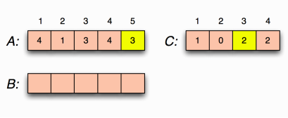
Counting sort example Loop 2
for j ←1 to n
do C [A[j ]] ←C [A[j ]] + 1
C [i ] = |{key = i}|

Slide 81
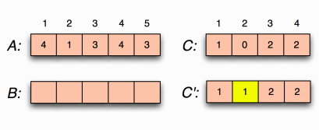
Counting sort example Loop 3
for i ←2 to k
do C [i ] ←C [i ] + C [i −1]
C [i ] = |{key ≤i}|

Slide 82
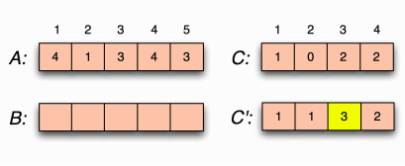
Counting sort example Loop 3
for i ←2 to k
do C [i ] ←C [i ] + C [i −1]
C [i ] = |{key ≤i}|

Slide 83
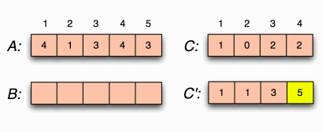
Counting sort example Loop 3
for i ←2 to k
do C [i ] ←C [i ] + C [i −1]
C [i ] = |{key ≤i}|

Slide 84
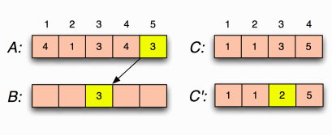
Counting sort example loop 4
for j ←n downto 1
do B[C [A[j ]]] ←A[j ]
C [A[j ]] ←C [A[j ]] −1

Slide 85
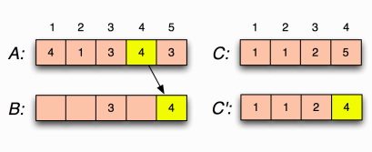
Counting sort example Loop 4
for j ←n downto 1
do B[C [A[j ]]] ←A[j ]
C [A[j ]] ←C [A[j ]] −1

Slide 86
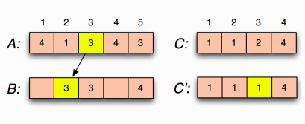
Counting sort example Loop 4
for j ←n downto 1
do B[C [A[j ]]] ←A[j ]
C [A[j ]] ←C [A[j ]] −1

Slide 87
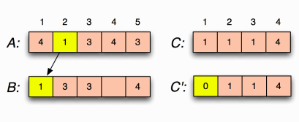
Counting sort example Loop 4
for j ←n downto 1
do B[C [A[j ]]] ←A[j ]
C [A[j ]] ←C [A[j ]] −1

Slide 88
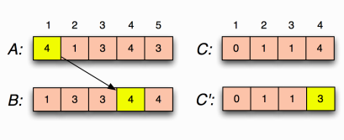
Counting sort example Loop 4
for j ←n downto 1
do B[C [A[j ]]] ←A[j ]
C [A[j ]] ←C [A[j ]] −1

Slide 89
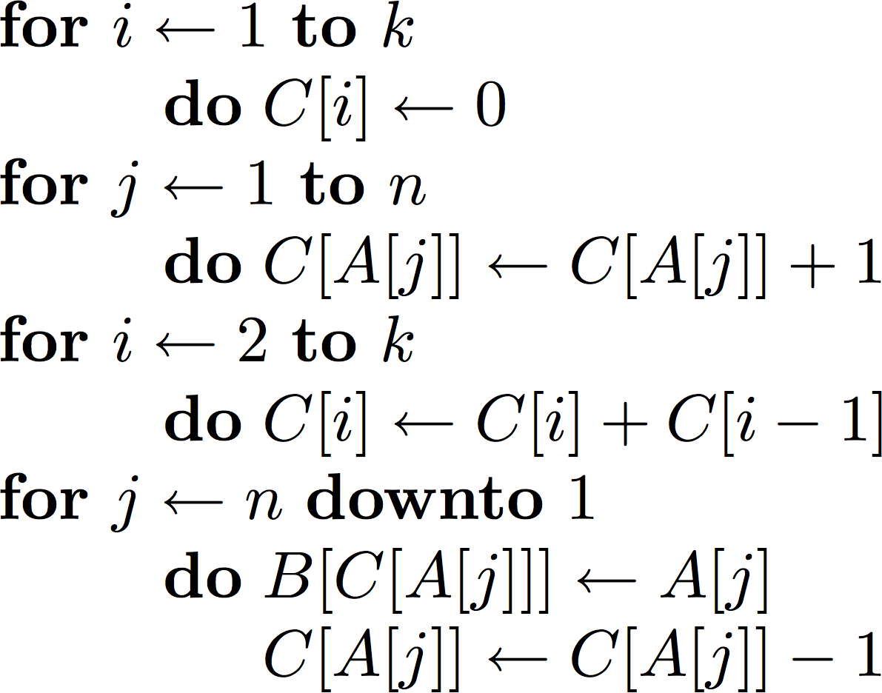
Counting sort Complexity
O(k)
O(n)
O(k)
O(n)
O(n + k)
The worst-case running time of Counting sort is O(n + k).
If k = n, then the worst case running time is O(n).

Slide 90
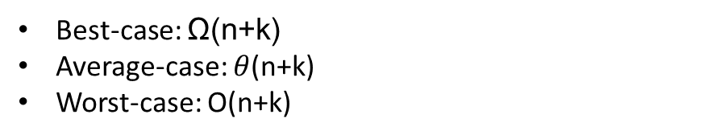
Counting Sort [Time Complexity]:
Best-case: Ω(n+k)
Average-case: $θ$(n+k)
Worst-case: O(n+k)
Counting Sort [Space Complexity]:
O(n+k)
[remember, k is the max element in the list. The larger it is, the more extra space is needed.]

Slide 91
In-place and Stable sorting
An in-place sorting algorithm is an algorithm which sorts an input list using no auxiliary data structure or extra storage. However, a small amount of extra storage space is allowed for auxiliary variables; usually not equal to or more than O(n). Examples include, Bubble sort, Selection sort, Insertion sort, Quicksort, etc.
Merge sort and Counting sort are not in-place.
A sorting algorithm is stable if whenever there are two records R and S with the same value and with R appearing before S in the original list, R will appear before S in the sorted list. Stable sorting algorithms maintain the relative order of records with equal values. Examples include, Bubble sort, Insertion sort, Merge sort, etc.
Quick sort, Heap sort, and Selection sort are not stable.

Slide 92
Books
Introduction to Algorithms, Thomas H. Cormen, Charle E. Leiserson,
Ronald L. Rivest, Clifford Stein (CLRS).
Fundamental of Computer Algorithms, Ellis Horowitz, Sartaj Sahni, Sanguthevar Rajasekaran (HSR)

Slide 93
References
https://www.google.com/search?q=bubble+sort+
step+by+step&sxsrf=ALeKk01uxzgfT3Oy6k1Q3WxVnSpiIN8_4g:1587999728942
&tbm=isch&source=iu&ictx=1&fir=vRwFsGwVfJ6pJM%253A%252CSzhhze6MPQr4c
M%252C_&vet=1&usg=AI4_-kSrEEXqwRL-PkHhVUtn7jNfF9dB6g&sa=X&ved=2ahUK
Ewje0Pz974jpAhXRAnIKHWhMD2UQ_h0wAXoECAcQBg#imgrc=EN4Sdu7veOWVo
M&imgdii=eOqvCu85p9-eBM
https://www.interviewcake.com/concept/java/counting-sort
https://www.geeksforgeeks.org/counting-sort/
https://www.hackerearth.com/practice/algorithms/sorting/quick-sort/tutorial/

